Slide 1

PAPPUS THEOREM

Slide 2
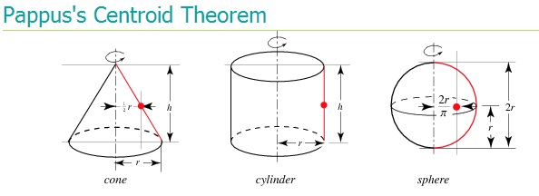


Slide 4
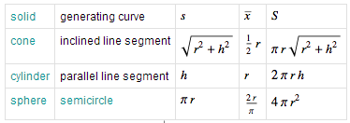
The following table summarizes the surface areas calculated using Pappus's centroid theorem for various surfaces of revolution.

Slide 5
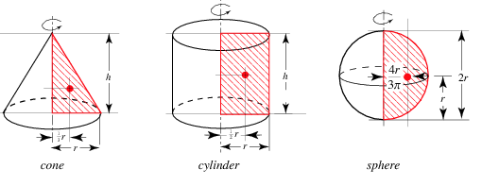


Slide 7
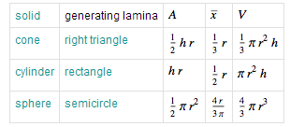
The following table summarizes the surface areas and volumes calculated using Pappus's centroid theorem for various solids and surfaces of revolution.

Slide 8
THEOREM OF PAPPUS
The Theorem of Pappus states that when a region R is rotated about a line l, the volume of the solid generated is equal to the product of the area of R and the distance the centroid of the region has traveled in one full rotation.

Slide 9
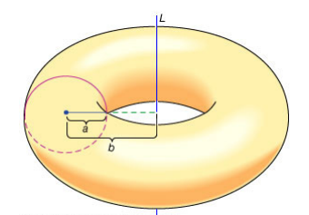
EXAMPLE
1. Find the volume bounded by a doughnut – shaped surface formed by rotating a circle of radius a about an axis whose distance from the circle’s center is b.

Slide 10
2. Find the centroid of the semicircular area in the 1st and 4th quadrant bounded by using Pappus’ Theorem.
3. Find the volume of a circular cone of radius and height h using Pappu’s Theorem.

Slide 11
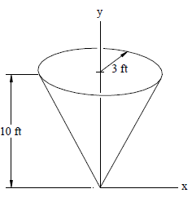
4. Determine the amount of paint required to paint the inside and outside surfaces of the cone, if one gallon of paint covers 300 ft2 using Pappu’s Theorem.

Slide 12
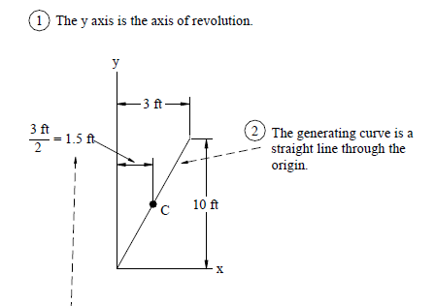

Slide 13
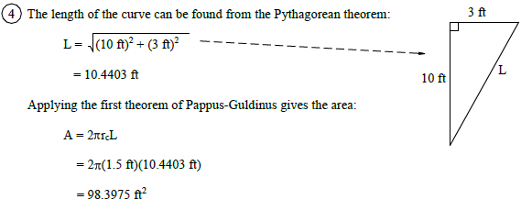

Slide 14
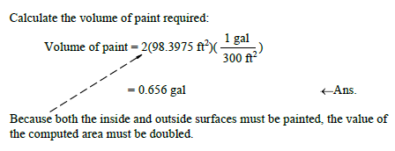

Slide 15
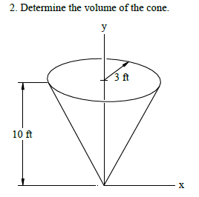

Slide 16
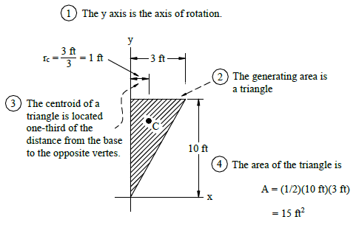

Slide 17
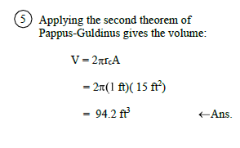

Slide 18
5. A right circular cone is generated when the region bounded by the line y = x and the vertical lines x = 0 and x = r is revolved about the x axis.
Use the Theorem of Pappus to show that the volume of this cone
is
Use the second Theorem of Pappus to determine the surface area of this region as well.
Verify this with the surface area formula for a cone.
6. Find the volume of the solid figure generated by revolving an equilateral triangle of side L about one of its sides. Use the Theorem of Pappus to determine the surface area of this region as well.

Slide 19
7. Let R be the triangular region bounded by the line y = x, the x-axis, and the vertical line x = r. When R is rotated about the x-axis, it generates a cone of volume
Use the Theorem of Pappus to determine the y-coordinate of the centroid of R. Then use similar reasoning to find the x- coordinate of the centroid of R.
8. Find the volume of the solid figure generated when a square of side L is revolved about a line that is outside the square, parallel to two of its sides, and located s units from the closer side. Use the
second Theorem of Pappus to determine the surface area of this region as well.

Slide 20
